Slide 1






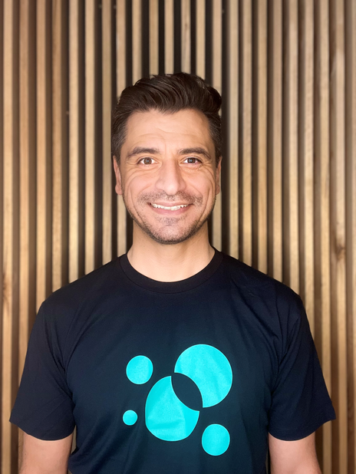

Direnc Uysal
Meet
Direnc
Chief Technologist
Responsible for technical governance and oversight of new and in-flight client
engagements. Key contact and escalation path if required.
Direnc is a passionate technologist dedicated to assisting organisations deliver value through effective engagement with their people, systems and processes. With over 15 years of experience in Defence, FMCG, Banking, Superannuation and the start-up world, Direnc thrives on contributing to organisational strategy to ensure that business outcomes are realised through the effective use of technology.
As Chief Technologist, Direnc is focused on defining the organisation's solution strategy alongside emerging technology partners and building the internal technical capability. Direnc’s areas of speciality include technology strategy, architecture and delivery, emerging technology, data, digital, and innovation.
Direnc is also a key member of a number of technology-focused meetups and community forums including former host of the Robotics Process Automation Meetup in Melbourne and part of the global Kids code initiative.

